Slide 1
UNIT-II (Part-2)
Basic Structural Modeling
Classes
Relationships
Common Mechanisms
Diagrams

Slide 2
CLASSES
Classes are the most important building block of an object oriented system.
A class is a description of a set of objects that share the same attributes, operations, relationships and semantics.
A class implements one or more interfaces.
Ex: In Java language
class UrClassName implements InteraceName

Slide 3
Classes are used to capture the vocabulary of the system you are developing.
Classes may include abstractions that are part of the problem domain.

Slide 4
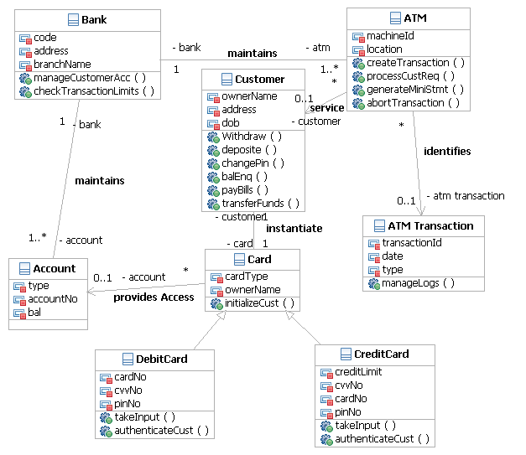
No. of Class examples

Slide 5
The UML provides a graphical representation of class.
Name
Shape
origin
move( ) resize( ) display( )
Attributes
Operations
CLASS

Slide 6
Terms and concepts
A class is a description of a set of objects that share the same attributes, operations, relationships, and semantics.
NAME:-
Every class must have a name that distinguishes it from other classes.

Slide 7
A name is a textual string. That name alone is known as a Simple name; a path name is the class name prefixed by the name of the package in which that class lives.
A class may be drawn showing only its name.
Temperature Sensor
Customer
Wall
Simple Names

Slide 8
Capitalize the first letter of every word in a class name, as in Customer or TemperatureSensor.
Business Rules:: Fraud Agent
Java :: awt :: Rectangle
Path Names

Slide 9
ATTRIBUTES:-
An Attribute is a named property of a class .
A class may have any number of attributes or no attributes at
all.

Slide 10
An attribute represents some property of the thing you are modeling that is shared by all objects of that class.
Example: Customer has a name, address, phone number, and date of birth.
Customer
name address phone birthDate
Attributes

Slide 11
An attribute name may be text, just like a class name.
Wall
height: Float Width: Float Thickness: Float isLoadBearing: Boolean= False

Slide 12
OPERATION:-
An operation is the implementation of a service that can be requested from any object of the class to affect behavior.
In other words, an operation is an abstraction of something you can do to an object and that is shared by all objects of the class.
A class may have any number of operations or no operations at all.

Slide 13
Rectangle
add( ) grow( ) move( ) isEmpty( )
Operations

Slide 14
RESPONSIBILITIES:-
A responsibility is a contract or an obligation of the class.
Responsibilities are translated into a set of attributes and operations that best fulfill the class’s responsibilities.
Example: A TemperatureSensor class is responsible is responsible for measuring the temperature and raising the alarm if the temperature reaches a certain point.

Slide 15
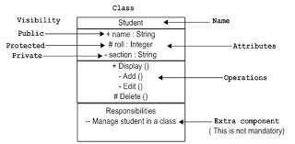
Example:
Supplier
Responsibilities -- Receive the order from the customer --Supply the goods to the customer.

Slide 16
Common Modeling Techniques
1.Modeling the vocabulary of a system:-
Classes are used to model abstractions that are drawn from the problem. Each of these abstractions is a part of the vocabulary of the system.
CRC card technique or use-case based analysis techniques are best methods to find these abstractions.

Slide 17
To model the vocabulary of a system:
Identify the things that users or implementers use to describe the problem or solution. Use CRC cards and use case-based analysis to help find these abstractions.
For each abstraction, identify the corresponding responsibilities.
For each class, provide the attributes and operations which are required to handle the responsibilities.

Slide 18
Example: Retail system.
Customer, order and product are the abstractions. A few other related abstractions drawn from the vocabulary of the problem, such as shipment( used to track orders), Invoice ( used to bill orders), and Warehouse (where products are located prior to shipment). There is also one solution related abstraction, Transaction, which applies to orders and shipments.

Slide 19
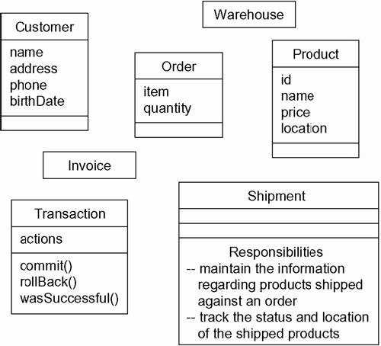

Slide 20
2. Modeling the distribution of responsibilities in a system:-
To model a system, the abstractions provide a balanced set of responsibilities. (What this means is that we don’t want any one class to be too big or too small.)
The UML is used to help us to visualize and specify this balance of responsibilities.

Slide 21
To model the distribution of responsibilities in a system:-
Identify the set of classes that work together to carry-out some behavior.
Identify the set of responsibilities for each of the classes.
Split classes that have too many responsibilities into smaller abstractions and reallocate responsibilities so that each abstraction reasonably stands on its own.

Slide 22
Find the collaborations among these classes and redistribute their responsibilities according so that no class within a collaboration does too much or too little.

Slide 23

MVC Architecture
Model, captures the behavior of the application in terms of its problem domain.
The model directly manages the data, logic and rules of the application.
View can be any output representation of information,
controller, accepts input and converts it to commands for the model or view.[6]

Slide 24
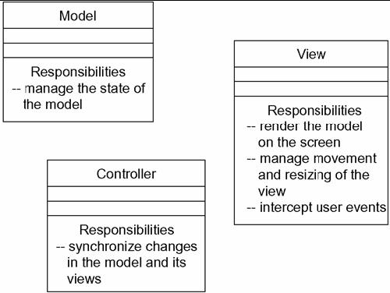
Modeling the Distribution of Responsibilities in a System

Slide 25
3. Modeling Non Software Things:-
Model the things, that are abstracting as a class.
(Example: Customer in a retail system)
Create a new building block by using stereotypes to specify the new semantics.
If the thing we are modeling is some kind of hardware that itself contains software, consider modeling it as a kind of node.

Slide 26
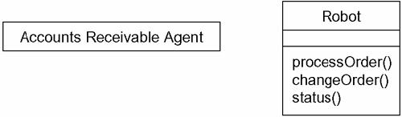
Modeling Nonsoftware Things

Slide 27
4. Modeling Primitive types:-
Model the thing we are abstracting as a type or an enumeration, which is represented using class notation with the appropriate stereotype.
Use constraints, to specify the range of values associated with the type.

Slide 28
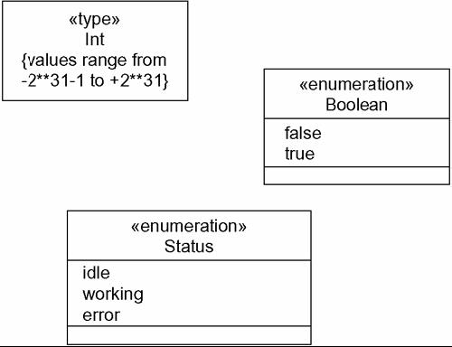
Modeling Primitive Types

Slide 29
Relationships
A relationship is a connection among things.
In object-oriented modeling, the three most important relationships are dependencies, generalization and association.

Slide 30
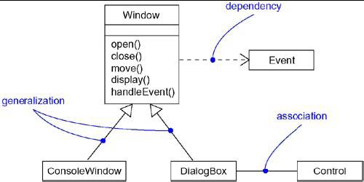

Slide 31
(1) DEPENDENCY
A dependency is a using relationship that states that a change in specification of one thing( for example, class Event) may affect another thing that uses it ( for example, class Window), but not necessarily the reverse.
Graphically, a dependency is rendered as a dashed directed line, directed to the thing being depended on.

Slide 32
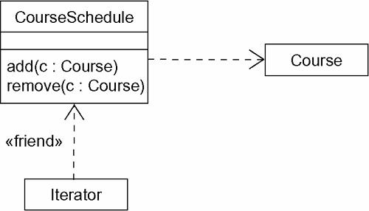

Slide 33
Use dependencies when you want to show one thing using another.
In the UML you can also create dependencies among many other things, especially notes and packages.

Slide 34
(2) GENERALIZTION
A Generalization is relationship between a general thing( called the Super class or parent) and a more specific kind of that thing( called the Subclass or child).
Generalization is sometimes called “is-a-kind of” relationship.
Generalization means that objects of the child may be used anywhere the parent may appear, but not the reverse.

Slide 35
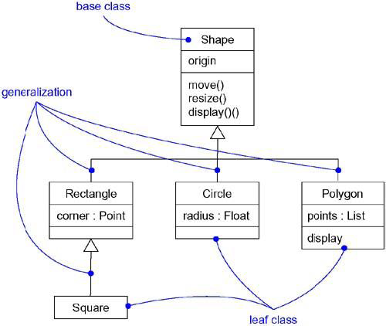

Slide 36
An operation of a child that has the same signature as an operation in a parent overrides the operation in a parent; this is known as polymorphism.
Use generalizations when you want to show parent/child relationship.

Slide 37
A class may have zero, one or more parents.
A class that has no parents and one or more children's is called a Root class or a Base class.
A class that has no children is called a Leaf class.
A class that has exactly one parent is said to use single inheritance, a class with more than one parent is said to use multiple inheritance.
In the UML, you can also create generalizations among other things most notably, packages.

Slide 38
(3) ASSOCIATION
An Association is a structural relationship that specifies that objects of one thing are connected to objects of another.
Given an association connecting two classes, you can navigate from an object of one class to an object of the other class and vice versa.

Slide 39
An Association that connects exactly two classes is called a Binary Association.
Associations that connect more than two classes; these are called n-ary associations.
Use associations when you want to show structural relationships.

Slide 40
Beyond this basic form, there are four adornments that apply to associations.
NAME:-
An association can have a name, and you use that name to describe the nature of the relationship.
You can give a direction to the name by providing a direction triangle that points in the direction you intend to read the name.

Slide 41
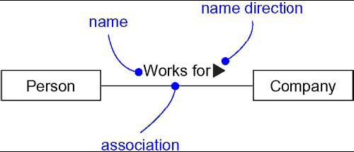
NAME

Slide 42
ROLE:-
When a class participates in an association, it has a specific role that it plays in that relationship.
You can explicitly name the role a class plays in an association.
Example: A Person playing the role of Employee is associated with a company playing the role of Employer.

Slide 43
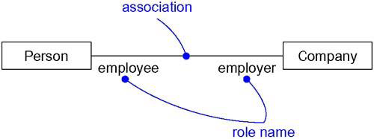
ROLE

Slide 44
MULTIPLICITY:-
An association represents a structural relationship among objects.
To state how many objects may be connected across an instance of an association.
This “how many” is called the multiplicity of an association’s role.

Slide 45
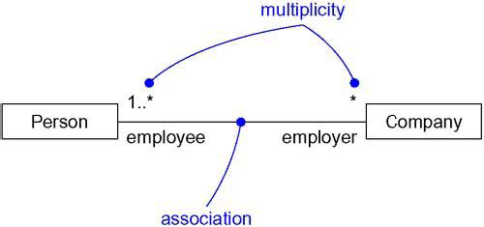
MULTIPLICITY

Slide 46
AGGREGATION:-
A plain association between two classes represents a structural relationship between peers.
To model a “ Whole/part” relationship, in which one class represents a large thing( the “whole”), which consists of smaller things ( the “Parts”). This kind of relationship is called AGGREGATION, which represents a “has-a” relationship, meaning that an object of the whole has objects of the part.

Slide 47
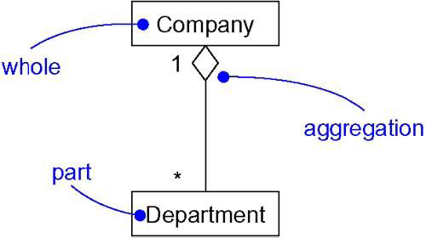
College
Aggregation

Slide 48
Aggregation is really just a special kind of association and is specified by adorning a plain association with an open diamond at the whole end.
Composition:-
Composition is a special form of aggregation within which the parts are inseparable from the whole.
Hand
Finger

Slide 49
COMMON MODELING TECHNIQUES
Modeling Simple Dependencies:-
Create a Dependency pointing from the class with the operation
to the class used as a parameter in the operation.

Slide 50
Modeling Single Inheritance:-
Given a set of classes, look for responsibilities, attributes and operations which are common to two or more classes.
Elevate these common responsibilities, attributes and operations to a more general class. If necessary create a new class to which we can assign these elements.
Specify that the more-specific classes inherit from more-general class by placing a generalization relationship that is drawn from each specialized class to its more-general parent.

Slide 51
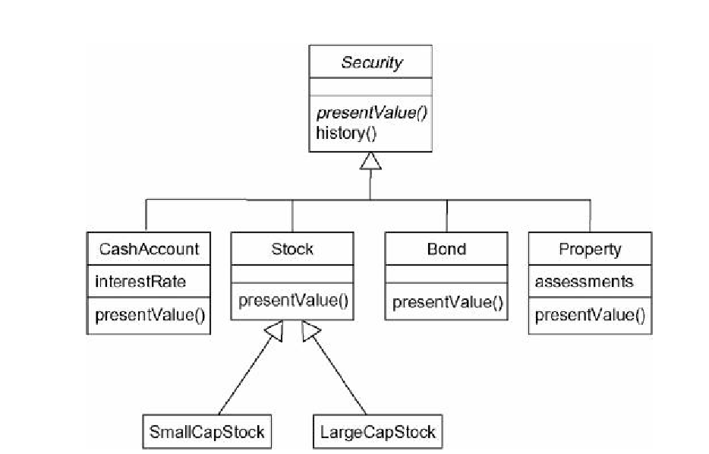
Inheritance Relationships

Slide 52
Modeling Structural Relationships:-
For each pair of classes, if we need to navigate from objects of one class to objects of another class, specify an association between the two.
For each of these associations, specify a multiplicity as well as role names.
If one of the classes in an association is structurally or organizationally a whole compared with the classes at the other end look like parts, mark this as an aggregation by adorning the association at the end near the whole.

Slide 53
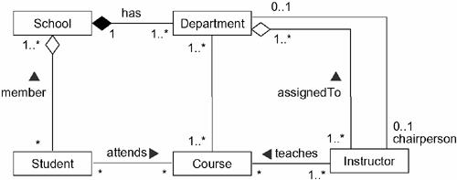
Structural Relationships

Slide 54
Common Mechanisms
The UML is made simpler by the presence of four common mechanisms that apply consistently throughout the language: specifications, adornments, common divisions, and extensibility mechanisms.

Slide 55
Notes:-
Graphical symbol for rendering constraints or comments attached to an element or collection of elements.
No Semantic Impact: does not alter the meaning of the model.
Specify things like: Requirements, Observations, Reviews, Explanations, Constraints

Slide 56
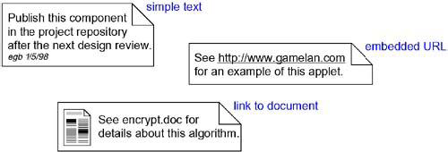
Notes

Slide 57
Adornments:-
Adornments are textual or graphical items that are added to an elements basic notation and are used to visualize details from the elements specification.
Placed near the element as
Text
Graphic
Special compartments for adornments in
Classes
Components
Nodes

Slide 58
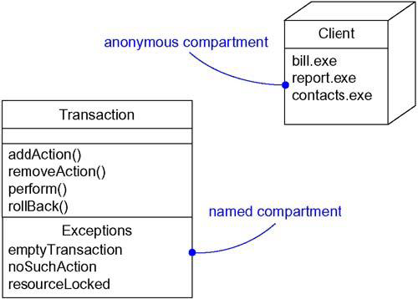
Extra Compartments

Slide 59
Stereotypes:-
A Stereotype is a metatype, because each one creates the equivalent of a new class in the UML’s methodology.
Named stereotype
Named stereotype with Icon
Stereotype element as Icon

Slide 60
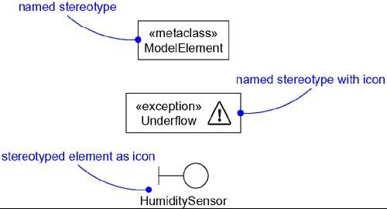
Stereotypes

Slide 61
Tagged Values:-
Tagged values add new properties.
A tagged value is not the same as a class attribute. Rather, you can think of a tagged value as metadata because its value applies to the element itself, not its instances.

Slide 62
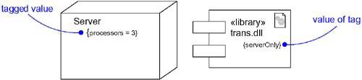
Tagged Values

Slide 63
Constraints:-
Constraints add new semantics or change existing rules.
A constraint specifies conditions that must be held true for the model to be well-formed.

Slide 64
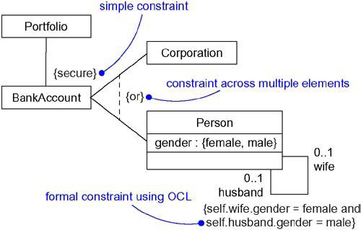
Constraint

Slide 65
Common Modeling Techniques
Modeling Comments
To model a comment:-
Put your comment as text in a note and place it adjacent to the element to which it refers. You can show a more explicit relationship by connecting a note to its elements using a dependency relationship.
Remember that you can hide or make visible the elements of your model. This means that you don't have to make your comments visible everywhere the elements to which it is attached are visible.

Slide 66
If your comment is lengthy or involves something richer than plain text, consider putting your comment in an external document and linking or embedding that document in a note attached to your model.
As your model evolves, keep those comments that record significant decisions that cannot be inferred from the model itself

Slide 67
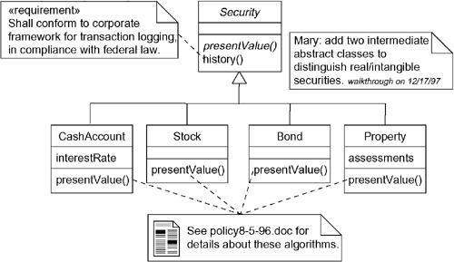

Slide 68
Modeling New Building Blocks:-
Make sure there's not already a way to express what you want by using basic UML. If you have a common modeling problem, chances are there's already some standard stereotype that will do what you want.

Slide 69
Diagrams
The static parts of a system using one of the four following diagrams.
1. Class diagram
2. Object diagram
3. Component diagram
4. Deployment diagram

Slide 70
Five additional diagrams to view the dynamic parts of a system.
1. Use case diagram
2. Sequence diagram
3. Collaboration diagram
4. Statechart diagram
5. Activity diagram
The UML defines these nine kinds of diagrams

Slide 71
Structural Diagrams
The UML's four structural diagrams exist to visualize, specify, construct, and document the static aspects of a system.
The static aspects of a system represents stable skeleton.

Slide 72
The UML's structural diagrams are roughly organized around the major groups of things you'll find when modeling a system.
1. Class diagram--- Classes, interfaces, and collaborations
2. Object diagram--- Objects
3. Component diagram---Components
4. Deployment diagram---Nodes

Slide 73
1.Class Diagram
A class diagram shows a set of classes, interfaces, and collaborations and their relationships.
Class diagrams are the most common diagram found in modeling object-oriented systems.
Class diagrams are used to illustrate the static design view of a system.
Class diagrams that include active classes are used to address the static process view of a system.

Slide 74
2. Object Diagram
An object diagram shows a set of objects and their relationships.
Object diagrams address the static design view or static process view of a system just as do class diagrams.

Slide 75
3. Component Diagram
A component diagram shows a set of components and their relationships.
Component diagrams are used to illustrate the static implementation view of a system.
Component diagrams are related to class diagrams in that a component typically maps to one or more classes, interfaces, or collaborations.

Slide 76
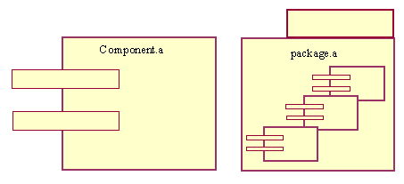
component diagram

Slide 77
4. Deployment Diagram
A deployment diagram shows a set of nodes and their relationships.
Deployment diagrams are used to illustrate the static deployment view of an architecture.
Deployment diagrams are related to component diagrams in that a node typically encloses one or more components.

Slide 78
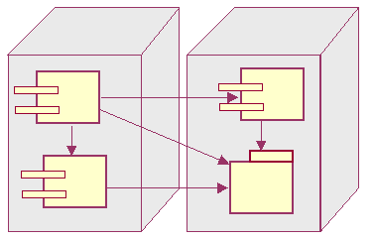
deployment diagram

Slide 79
Behavioral Diagrams
The UML's five behavioral diagrams are used to visualize, specify, construct, and document the dynamic aspects of a system.
You can think of the dynamic aspects of a system as representing its changing parts.
The dynamic aspects of a software system encompass things as the flow of messages over time and the physical movement of components across a network.

Slide 80
The UML's behavioral diagrams are roughly organized around the major ways you can model the dynamics of a system.
1. Use case diagram--- Organizes the behaviors of the system.
2. Sequence diagram ---Focused on the time ordering of messages.
3. Collaboration diagram---Focused on the structural organization of objects that send and receive messages.
4. Statechart diagram---Focused on the changing state of a system driven by events.
5. Activity diagram---Focused on the flow of control from activity to activity.

Slide 81
Use Case Diagram
A use case diagram shows a set of use cases and actors (a special kind of class) and their relationships.
Apply use case diagrams to illustrate the static use case view of a system.
Use case diagrams are especially important in organizing and modeling the behaviors of a system.

Slide 82
Interaction diagram
Interaction diagram is the collective name given to sequence diagrams and collaboration diagrams.

Slide 83
Sequence Diagram
A sequence diagram is an interaction diagram that emphasizes the time ordering of messages.
A sequence diagram shows a set of objects and the messages sent and received by those objects.
Use sequence diagrams to illustrate the dynamic view of a system.

Slide 84
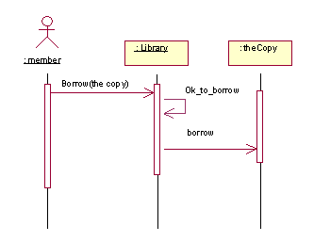
sequence diagram

Slide 85
Collaboration Diagram
A collaboration diagram is an interaction diagram that emphasizes the structural organization of the objects that send and receive messages.
A collaboration diagram shows a set of objects, links among those objects, and messages sent and received by those objects.
Use collaboration diagrams to illustrate the dynamic view of a system.

Slide 86
Statechart Diagram
A statechart diagram shows a state machine, consisting of states, transitions, events, and activities.
Use statechart diagrams to illustrate the dynamic view of a system.
Statechart diagrams emphasize the event-ordered behavior of an object, which is especially useful in modeling reactive systems.

Slide 87
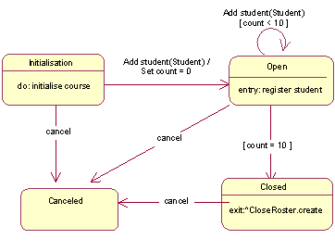
statechart diagram

Slide 88
Activity Diagram
An activity diagram shows the flow from activity to activity within a system.
An activity shows a set of activities, the sequential or branching flow from activity to activity.
Use activity diagrams to illustrate the dynamic view of a system.
Activity diagrams emphasize the flow of control among objects.

